Slide 1
On Application of Learning to Rank for E-Commerce Search
Shubhra Kanti Karmaker Santu (UIUC)
Parikshit Sondhi (WalmartLabs)
ChengXiang Zhai (UIUC)

Slide 2
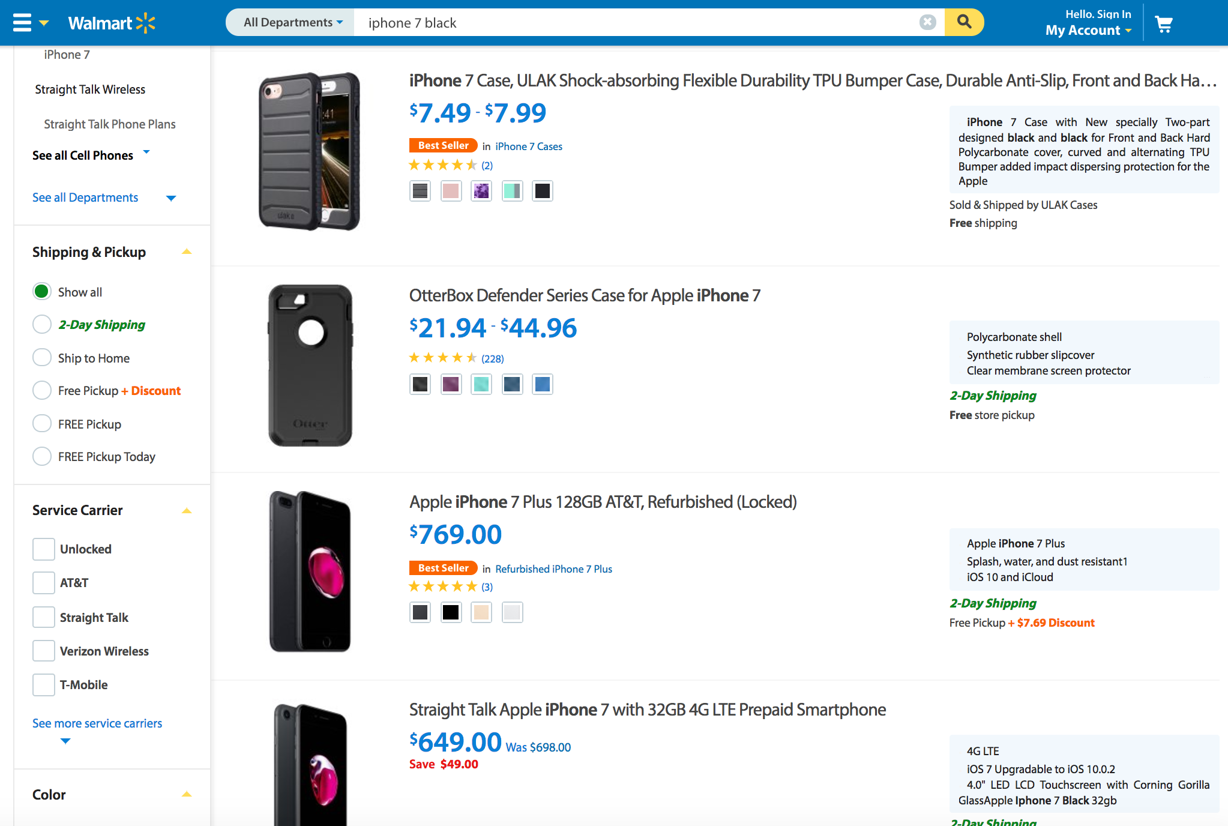
E-Commerce (ECOM) Search
Online shopping is very popular
Many E-commerce websites
Walmart
Amazon
Ebay etc
Search quality is Critical

Slide 3
The Ranking Problem
Given a query q, a catalog D (Millions of products) and a search log L, return the optimal ranked list
Optimality criteria:
Clicks, cart adds, order etc
We’ll just call them utility
Notes:
Didn’t talk about users, won’t be covering personalization for now.
Will frequently use the term conversion as an example. But replaceable with other criteria

Slide 4
Learning to RANK (LETOR)
Given a query (q) and a document (d), learn how relevant the document is w.r.t. the query
Learn a function: Relevance(q,d)
Sort products according to the score
Popular approaches:
LambdaMART
AdaRank
RankNet
Query (q)
Scoring function
Relevance (q,d)
Document (d)

Slide 5
High level research question
How to apply LETOR for E-com search?
Which method works the best for E-com?
How to create labels?
How do we generate features?

Slide 6




Relevance Label generation
Utility of a product to a query
Multiple Engagement signals
Clicks
Add-to-Cart
Orders
Revenue etc.

Slide 7
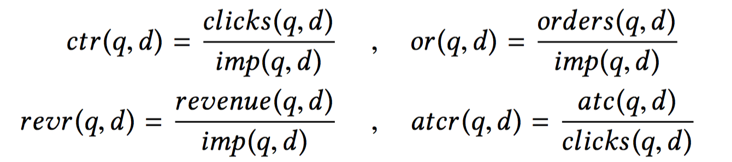
Relevance judgments from user feedback signals
Perceived Utility of Search results (Click Through Rate)
Perceived Utility of the Product Page (Add-to-Cart Ratio)
Overall User Satisfaction (Order Rate)
Business Value (Revenue Rate)

Slide 8
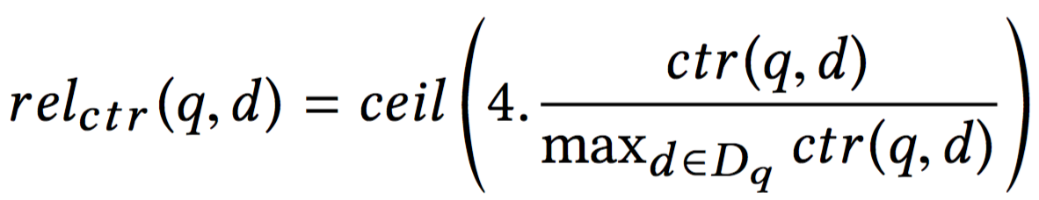
Relevance label creation
For each objective, compute relevance ratings by:
normalizing the objective value by its max
discretizing to a 5 point integer scale (0 − 4)
0 means non-relevant
4 means highly relevant

Slide 9
Relevance Label generation
Web search studies have used Crowd-sourcing to generate relevance labels
Unsuitable for E-com search (Revisit Later!)

Slide 10
Research question I
Which LETOR method is the best ?

Slide 11
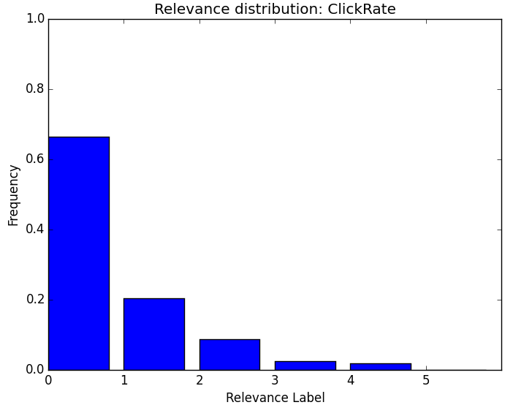
Experimental Design: Dataset
2.8K randomly selected product search queries from Walmart.com
Catalog of 5M product/documents
120 products per query using BM25F
For each (q, d ), computed
clicks (clicks(q,d))
add-to-carts(atc(q,d))
orders(orders(q,d))
revenue(rev(q,d))

Slide 12
Experimental Design: LETOR Approaches for evaluation
Methods | Short Form
RankNet | RNet
RankBoost | RBoost
AdaRank | ARank
Random Forest | RF
LambdaMART | LMART
Logistic Regression (L1 regularized) | L1LR
Logistic Regression (L2 regularized) | L2LR
SVM Classifier (L1 regularized, L2 Loss) | L1L2SVMC
SVM Classifier (L2 regularized, L1 Loss) | L2L1SVMC
SVM Regressor (L2 regularized, L2 Loss) | L2L2SVMR
SVM Regressor (L2 regularized, L1 Loss) | L2L1SVMR

Slide 13
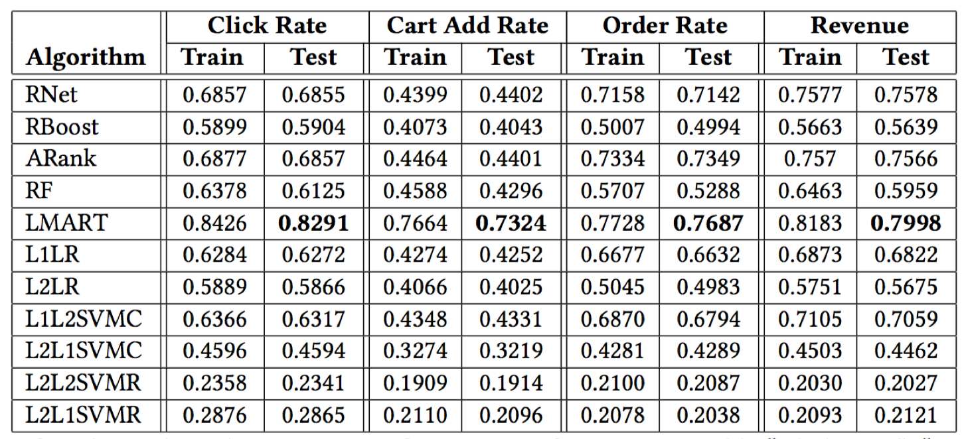
BENCHMARK STUDY
All results report 5 FCV NDCG@10

Slide 14
takeaway message 1
LambdaMART seems to be the best
Click rate is the easiest signal to predict
Add-to-cart seems to be the hardest

Slide 15
Research question 2
What’s the best way to exploit the
multiple feedback signals / objectives?

Slide 16
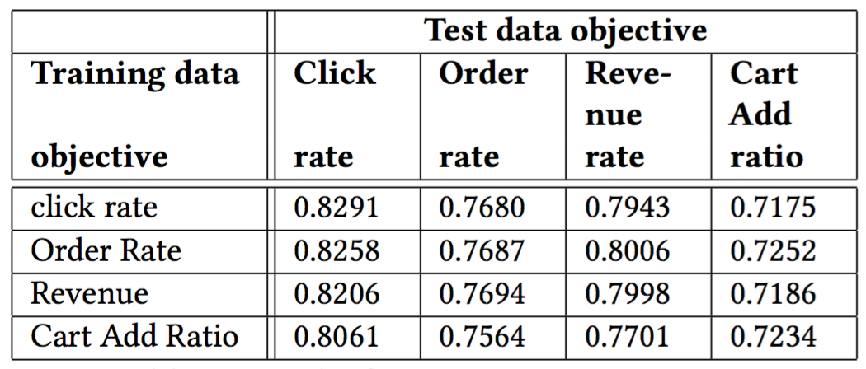
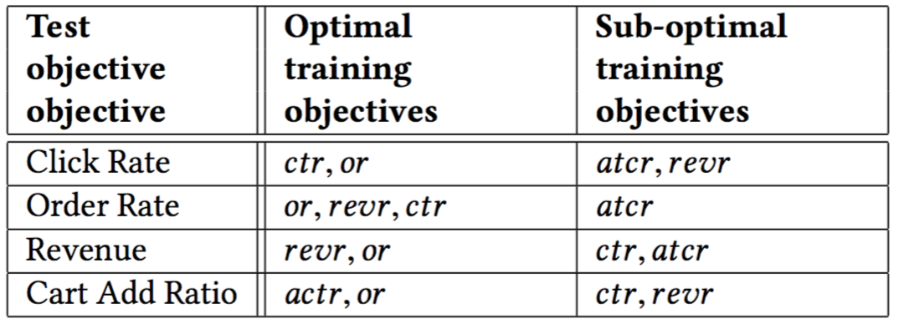
Cross Objective Learning Experiments

Slide 17
takeaway message 2
1. Order rate is the most robust training objective
2. Click rate is also very robust
3. Use click rate when sufficient order rate data is not available
4. Use order rate once it is available in a significant amount

Slide 18
Research question 3
Can we use Crowd-sourcing to generate relevance
judgments for E-Com search ?

Slide 19
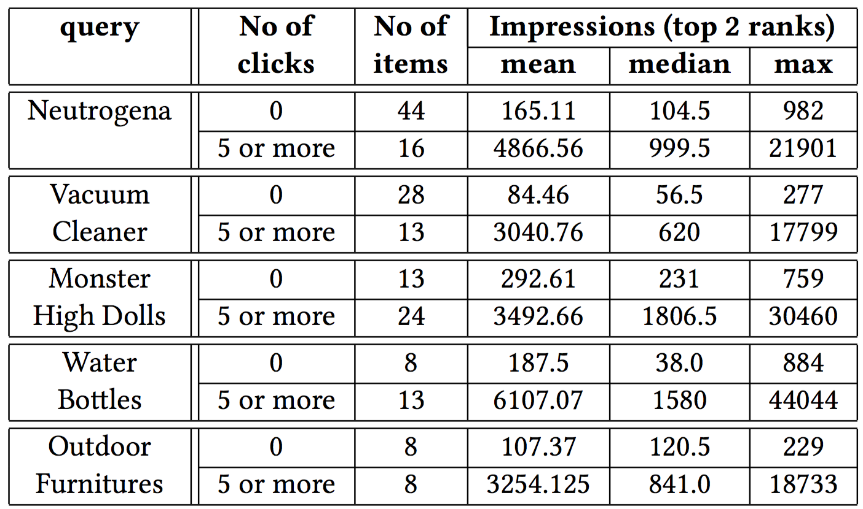
Reliability of crowd judgement

Slide 20
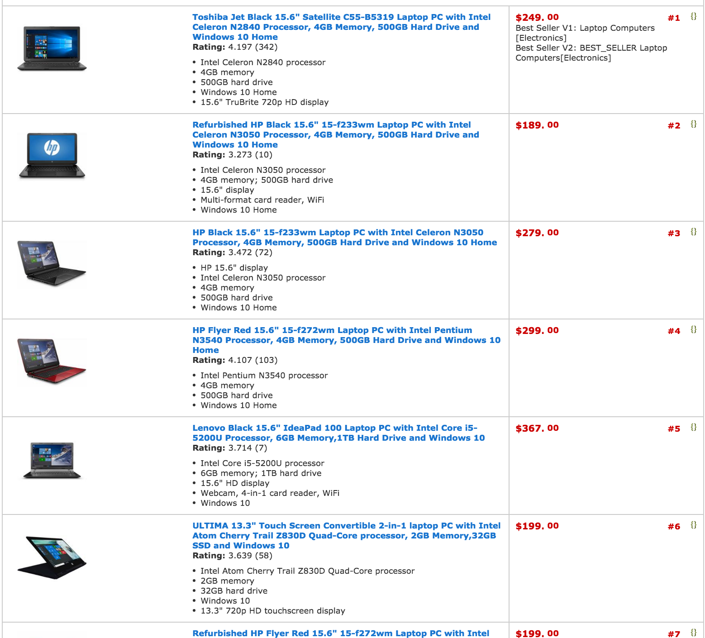
The problem with crowdsourcing

Slide 21
The problem with crowdsourcing
Human raters will rate them equally

Slide 22
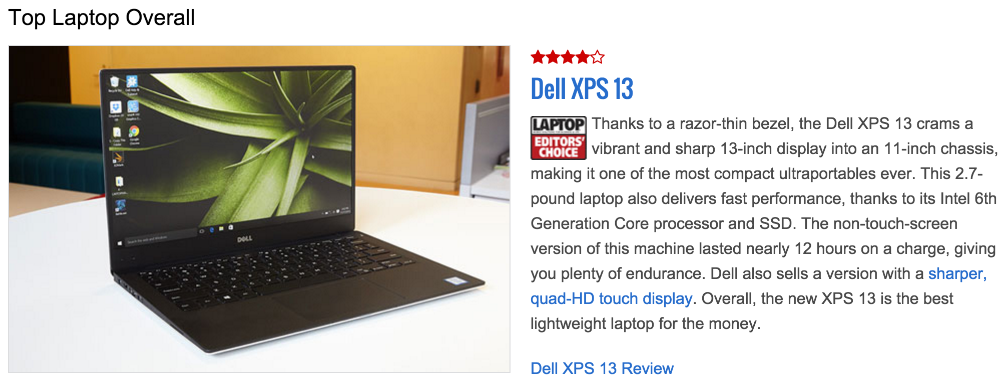
The problem with crowdsourcing

Slide 23
The problem with crowdsourcing
Purchase factors:
size, performance, display quality, battery life, price, reviews, ratings

Slide 24
takeaway message 3
Crowd-sourcing mostly generate unreliable
judgments for E-Com search

Slide 25
Features
Query Features:
Category, Department, Traffic Class, Product Type etc
Product Features:
Overall product sales, Rating, number of reviews, expected demand, Brand, price etc.
Query Product features:
Text match: query - product BM25F score
Query-Document attribute match: Is there a color attribute in both the query and the product?
Query-Document attribute value match: Does the color attribute for both query and produce match?

Slide 26
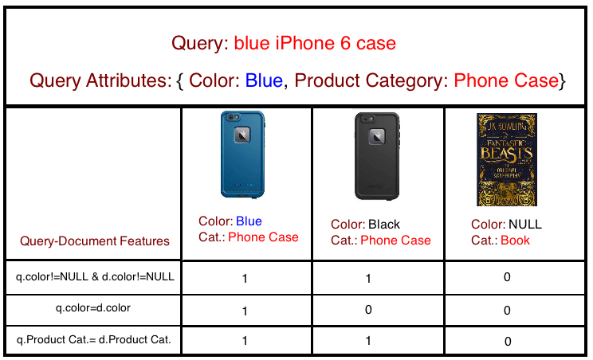
From attribute to feature construction
Query Specific Features
DocumentSpecific Features
Query-Document Matching Features

Slide 27
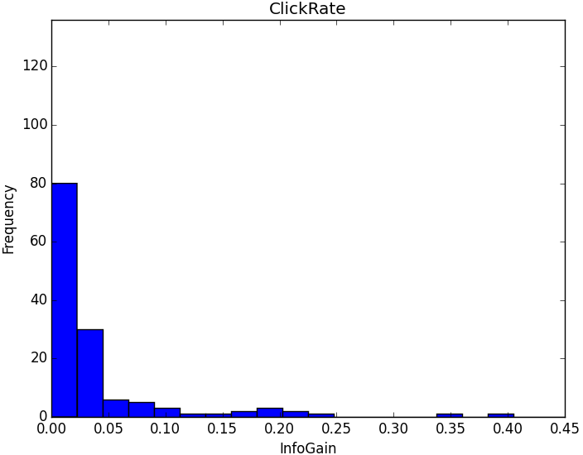
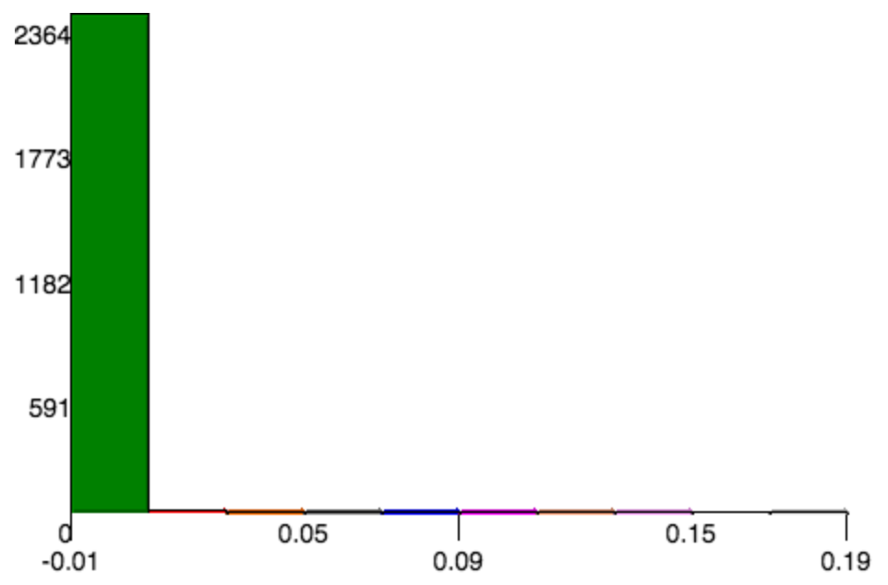
From attribute to feature construction
(Raw product attributes)
(Attribute Matching Features)
Information Gain w.r.t. Click Rate

Slide 28
Challenges in Feature representation
Are we done? NO!
Balancing of Relevance and Popularity
Query attribute sparsity

Slide 29
Research question 4
How well can LETOR methods
optimize the combination of
relevance-based vs popularity features?

Slide 30
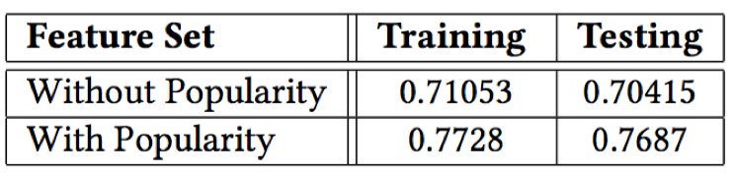
relevance-based vs popularity features
Popularity:
0.5
0.8
0.4

Slide 31
takeaway message 4
Popularity based features are indeed useful
for training a LETOR method

Slide 32
Research question 5
How well can LETOR methods handle
sparse query attributes by exploiting query department?

Slide 33
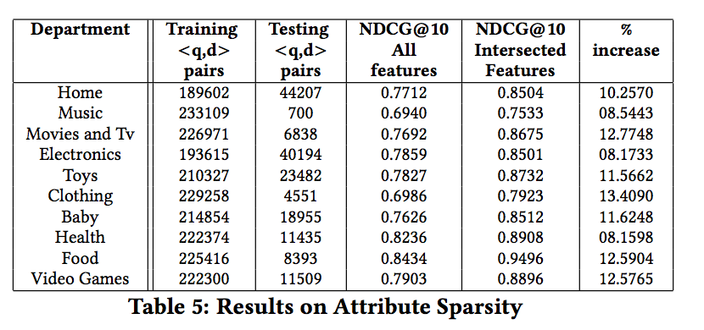
sparse query attributes

Slide 34
takeaway message 5
Selectively using a subset of features to avoid sparsity during training LETOR methods is beneficial.

Slide 35
Conclusions
LambdaMART seems to be the best
Click rate is the easiest , Add-to-cart is the hardest
Order rate is the most robust training objective, followed by Click rate
Initially use click rate, then switch to order rate eventually
Crowd-sourcing relevance labels is unreliable
Popularity based features are useful for training a LETOR method
Avoiding sparsity during training using department information is beneficial.

Slide 36
Future directions
E-COM specific directions:
What is the best way to combine different feedback signals?
Classify general vs specific queries and train different rankers for them
General directions:
Presence of Uncertain features
Correlated features
Data quality issues
Query sparsity
High variance in browsing depth: adaptive cutoff in NDCG

Slide 37

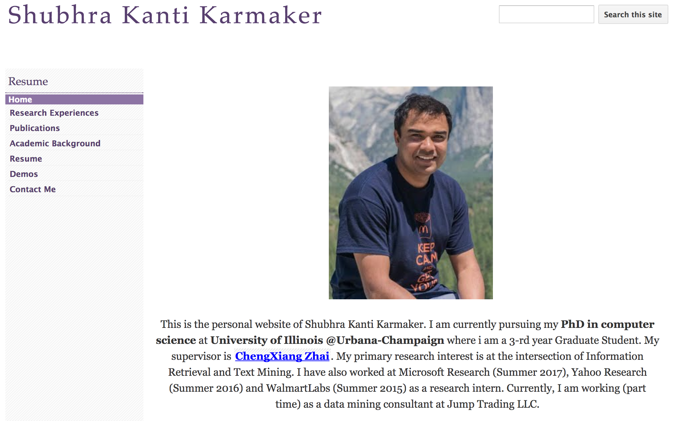
Questions
For further information, please visit my page: https://sites.google.com/site/kantishubhra006/

